Slide 1

C.V. RAMAN GLOBAL UNIVERSITY
ODISHA,BHUBANESWAR,INDIA
INDUSTRIAL INTERNSHIP ON
"EMBEDDED SYSTEMS" programming in off mode C.V. Raman Global University
PRESENTED BY;
NAME : RANA SUJEET KUMAR
REGD. NO. : 2101020306
GUIDED BY;
Mr. Mohammed Salahuddin

Slide 2
Internship Overview
Duration:
From 2nd July 2024 to 31st July 2024
Key Activities:
Gained hands-on experience with Embedded Systems Programming using STM32.
Worked on microcontroller peripherals and interfacing techniques.
Completed both theoretical learning (datasheets, schematics) and practical implementation.
Objective: To develop a strong foundation in low-level embedded programming and build projects using STM32 microcontrollers.

Slide 3
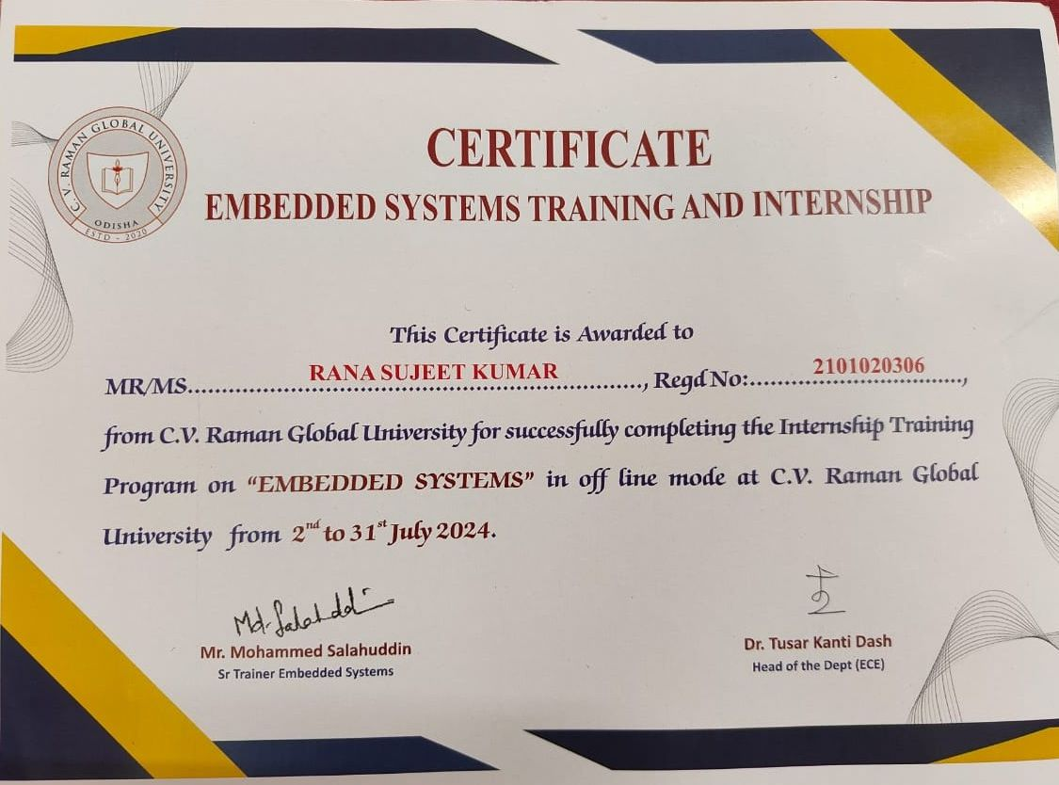
Certificate

Slide 4
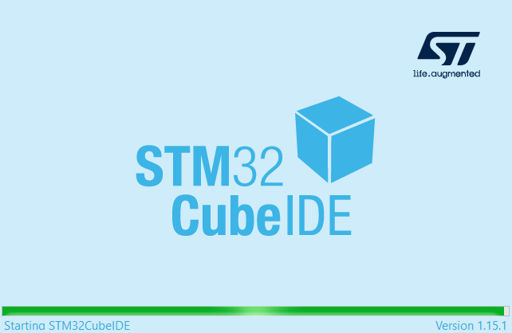
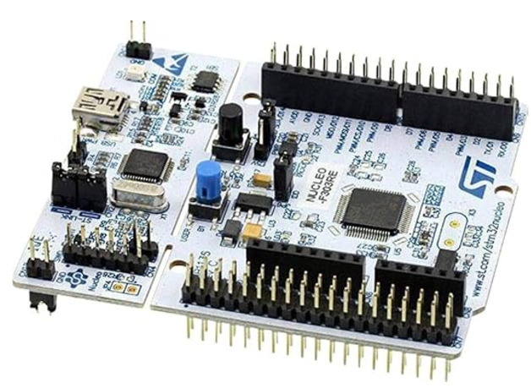
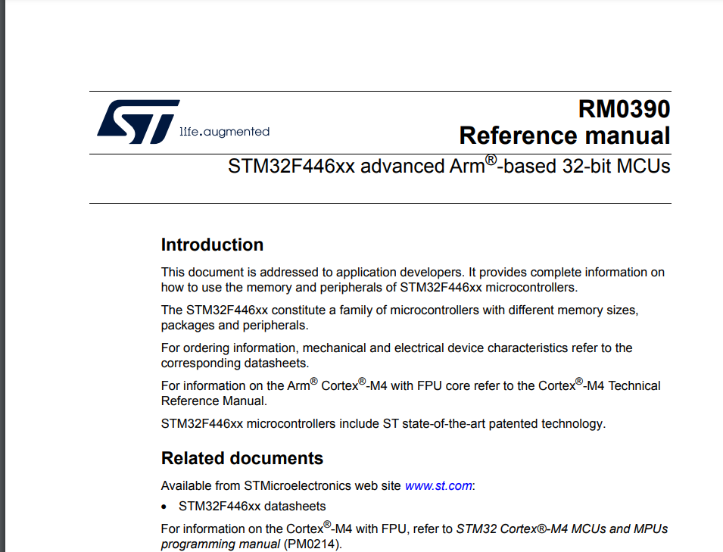
TOOLS AND RESOURCES USED :
Software Tools:
STM32CubeIDE
PulseView (for signal debugging)
Hardware Platforms:
STM32F446RE Nucleo Board
GPIO, UART, ADC, Timers, PWM modules
Datasheets and Documentation:
STM32F446RE Datasheet
RM0390 Reference Manual
User Manuals and Schematics for board configurations
Programming Languages:
C and C++: In-depth understanding and advanced coding techniques.

Slide 5
DAILY PROGRESS
Days 11–30:
Worked on practical mini-projects:
GPIO pin configuration and LED control.
UART communication for serial data transfer.
Timer, PWM, and Interrupt-based projects.
Finalized a major project integrating multiple peripherals with UART communication.
Days 1–10:
Focused on coding with C and C++, diving deep into their usage in embedded systems.
Studied datasheets and reference manuals to understand peripheral functionality.

Slide 6
MINI PROJECT REPOSETORIES
GitHub Repository: Embeded_C GitHub Projects
Highlighted Mini Projects:
GPIO Blinking LED: Controlled delay using peripherals and timers.
UART Communication: Real-time data transmission and reception.
PWM (Pulse Width Modulation): For LED brightness control.
SPI Communication: Data transfer between microcontroller and external devices.
Interrupts: Implemented interrupt-driven tasks for efficient processing.

Slide 7
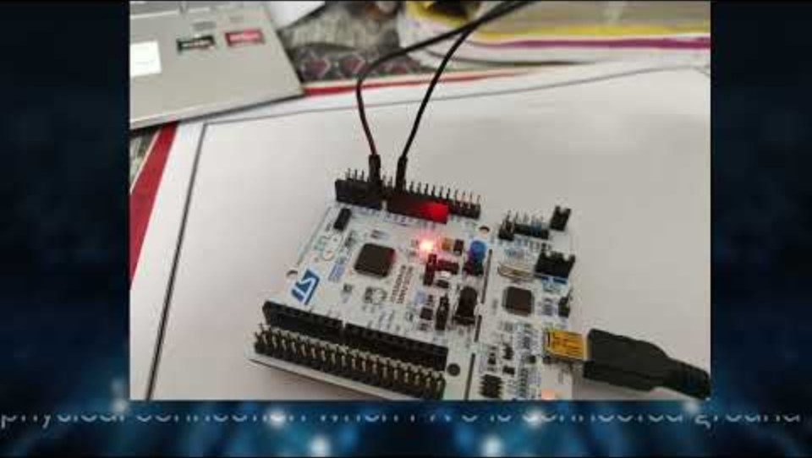
Main Project: UART-Based Menu-Driven Utility
Problem Statement: Developed a menu-driven utility for the STM32 microcontroller using UART communication.
Key Features:
ADC Data Acquisition:
Continuous analog-to-digital conversion.
Transmitted data via UART.
Interrupt Handling:
Configured multiple interrupts with priority levels.
User Command Interface:
Menu-based interaction through a UART terminal.
System Overview:
Clock and GPIO configuration for accurate timing and data exchange.
Continuous ADC operation integrated with UART communication.

Slide 8
ReSULT AND OUTCOMES
Results:
Successfully built and tested a UART-based utility.
Debugged and optimized STM32 peripherals for real-time tasks.
Delivered a robust embedded system showcasing GPIO, ADC, UART, and interrupt functionalities.
Learning Outcomes:
Mastered STM32CubeIDE and peripheral handling.
Improved problem-solving skills in embedded programming.
Enhanced understanding of communication protocols like UART and SPI.

Slide 9
ConCLUSION AND FUTURE SCOPE
The internship provided practical insights into embedded systems design and implementation.
Successfully combined hardware and software for real-time applications.
Future Scope:
Enhance existing projects with wireless communication (e.g., Bluetooth, Wi-Fi).
Integrate advanced peripherals like I2C and CAN for larger systems.
Explore IoT-based solutions using embedded platforms.
Acknowledgment: Special thanks to C.V. Raman Global University and Mr. Mohammed Salahuddin for their support and guidance.

Slide 10
Thank you

